Slide 1

Disability Sunday Quiz Answers

Slide 2
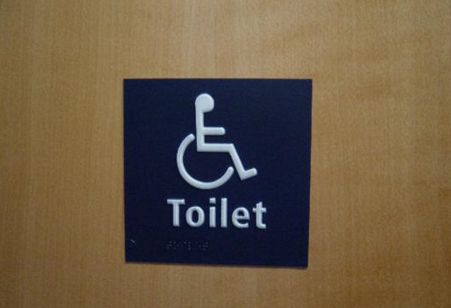
Question 1
b. Requires churches to make provision for disabled people even if they currently have no disabled members or visitors.
Unless a church is clearly welcoming to disabled members, none are likely to want to make it their home!

Slide 3
Question 2
c. Breaking the law. All “discrimination arising from disability” is illegal under the Equality Act 2010, and you cannot treat disabled people less favourably, for example by having inaccessible premises or services that exclude sight and hearing impaired worshippers
Would a guide dog be welcome in your services?

Slide 4


Question 3
a. A physical or mental impairment that has a ‘substantial’ and ‘long-term’ negative effect on your ability to do normal daily activities.
Is your lighting bright enough for someone to lip read?
Would you know where to find a sign language interpreter?

Slide 5
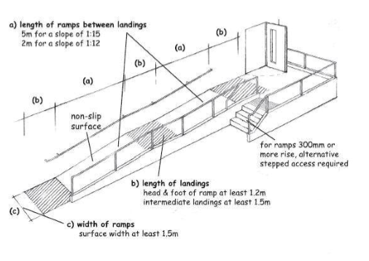
Question 4
b. Adaptations such as ramps and toilets that are not structurally impossible or prohibitively expensive have to be made.
Through the Roof has information that can help you with making your church accessible. Ask for our “Come in!” booklet.

Slide 6
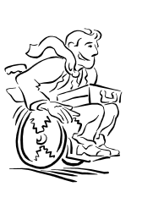
Question 5
b. Wheelchair user.
You’re not shoe-bound, are you? Confined to that bothersome footwear because your poor feeble feet aren’t tough enough for the pavement? Your shoes enable you to do amazing things. As does my wheelchair.

Slide 7
Question 6
c. Enable the wheelchair user to attend the party at the church’s expense.
The Equality Act forbids service providers to charge disabled people more for the same service as non-disabled people.

Slide 8

Question 7
b. 8%
Most disabilities are hidden, such as hearing impairment, epilepsy, mental illness, ME, MS and many others.

Slide 9
Question 8
b. All elders, leaders, church staff and volunteers such as stewards and Sunday school teachers.
The biggest barriers for disabled people in church come not from access problems but from attitudes. The more people who become aware, the friendlier the church will be.

Slide 10

Question 9
c. Implement the Equality Act in full, but go beyond that to look at how they can enhance the relationships so that disabled and non-disabled people in the church become fully interdependent.
1 Cor 12.23
abc

Slide 11
Question 10
b. Don’t assume anything – ask them how you can help them get the most out of their visit to your church.
Everyone is different. Some people like to be fully independent, others appreciate help. You can’t tell by looking, so ask!

