Slide 1
Disability Sunday Quiz 2015

Slide 2
1. In a recent SCOPE survey, what percentage of the British public admitted that they try to avoid disabled people?
67%

Slide 3
2. According to the World Health Organisation, how many disabled people are there in the world?
1 billion
Source:https://edci815.wikispaces.com/Special+Education

Slide 4
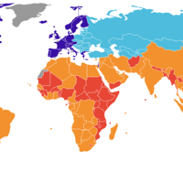
3. What percentage of the world’s disabled people live in developing countries?
80%
Source: http://www.boundless.com

Slide 5
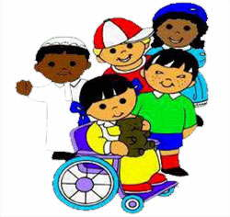
4. How many of the world’s disabled people are under the age of 18?
150 million
http://som.flinders.edu.au/FUSAWikis/dsrswiki01/doku.php?id=praca2010amaliefiebiger

Slide 6
5. According to the Chartered Institute of Housing, what proportion of people adversely affected by the bedroom tax are disabled?
Two thirds
http://infantile-disorder.blogspot.co.uk/2013/02/liverpool-housing-association-occupied.html

Slide 7
6. In the UK, what percentage of the working age population have a disability?
16%

Slide 8
7. In the UK, what percentage of adults of state pension age have a disability?
45%
Source: http://carlolara.wikispaces.com/file/detail/happy-old-man-in-walker.jpg/355880754?q=happy-old-man-in-walker.jpg

Slide 9
8. According to UK government figures, what percentage of children in families with a disabled member are living in poverty in this country?
21%
Source: http://challenge-global.wikispaces.com/7.+The+fight+against+Poverty

Slide 10
9. How likely are disabled adults in the UK not to hold any qualifications compared with the rest of the population?
3 times as likely
Source: https://friendshipwebquest.wikispaces.com/file/detail/education_clip_art.jpg/318245696

Slide 11
10. How likely are disabled people to suffer violence at work, compared with the rest of their colleagues?
3 times as likely
Source: colbycriminaljustice.wikidot.com

